Slide 1
GANs
https://github.com/timestocome/DeepLearning-Talks

Slide 2
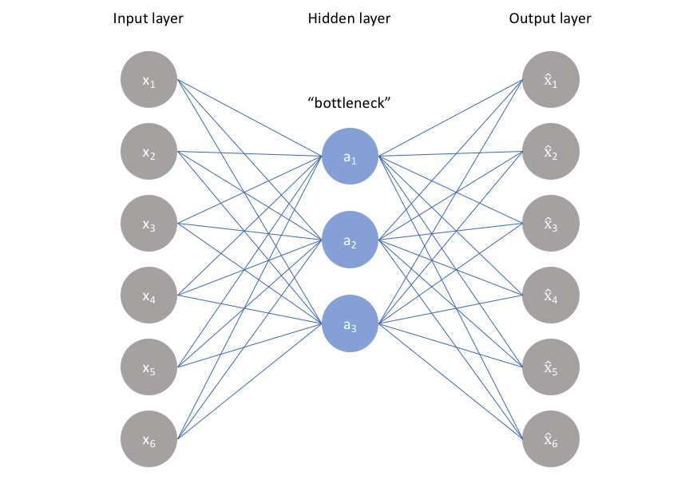
AutoEncoders
Compression, noise removal
Z space, Latent Space

Slide 3
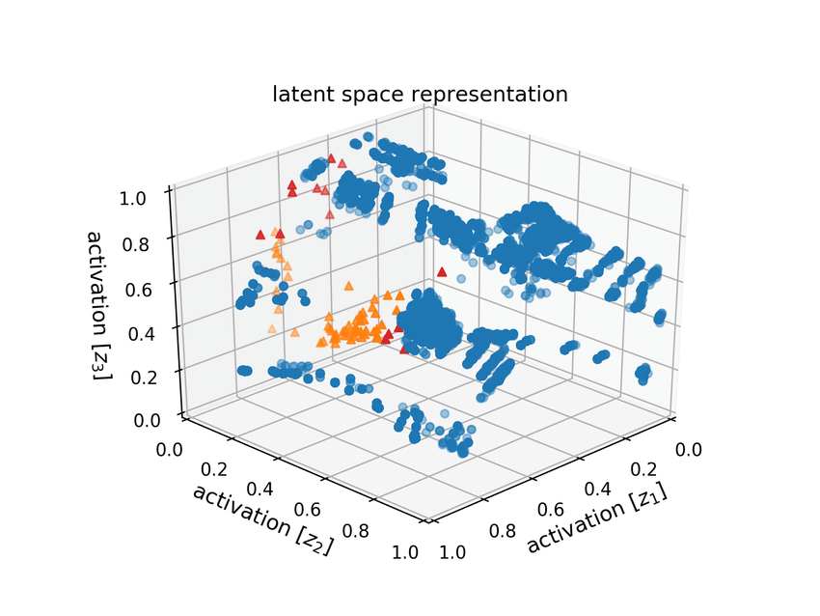
Latent Space, Z space
Not continuous
Can be mapped onto data but
poorly grouped, can't create similar
data

Slide 4
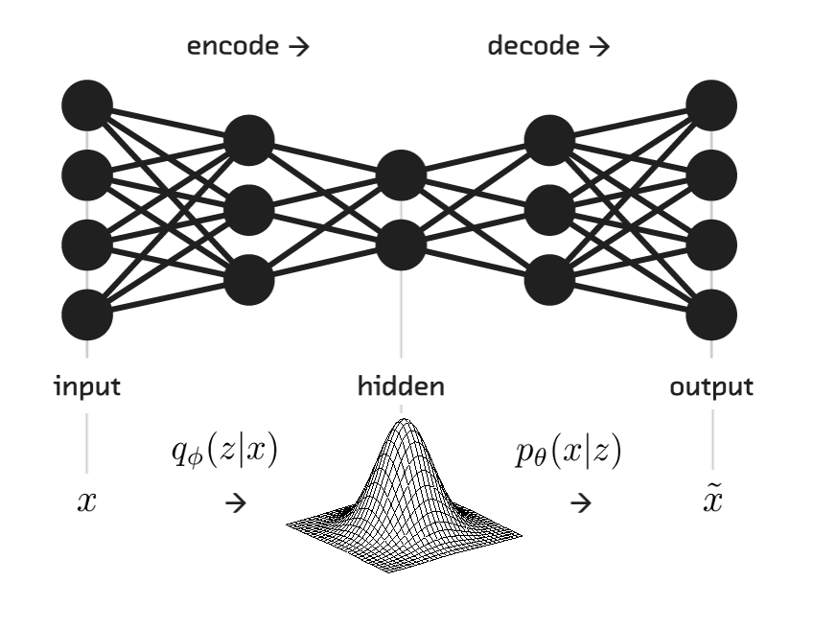

Variational Auto Encoders
Continuous Z Space
AE Cost function + KL Divergence
Similar data grouped together
Can create similar data
No clear way to measure how similar
How VanGogh is it?

Slide 5
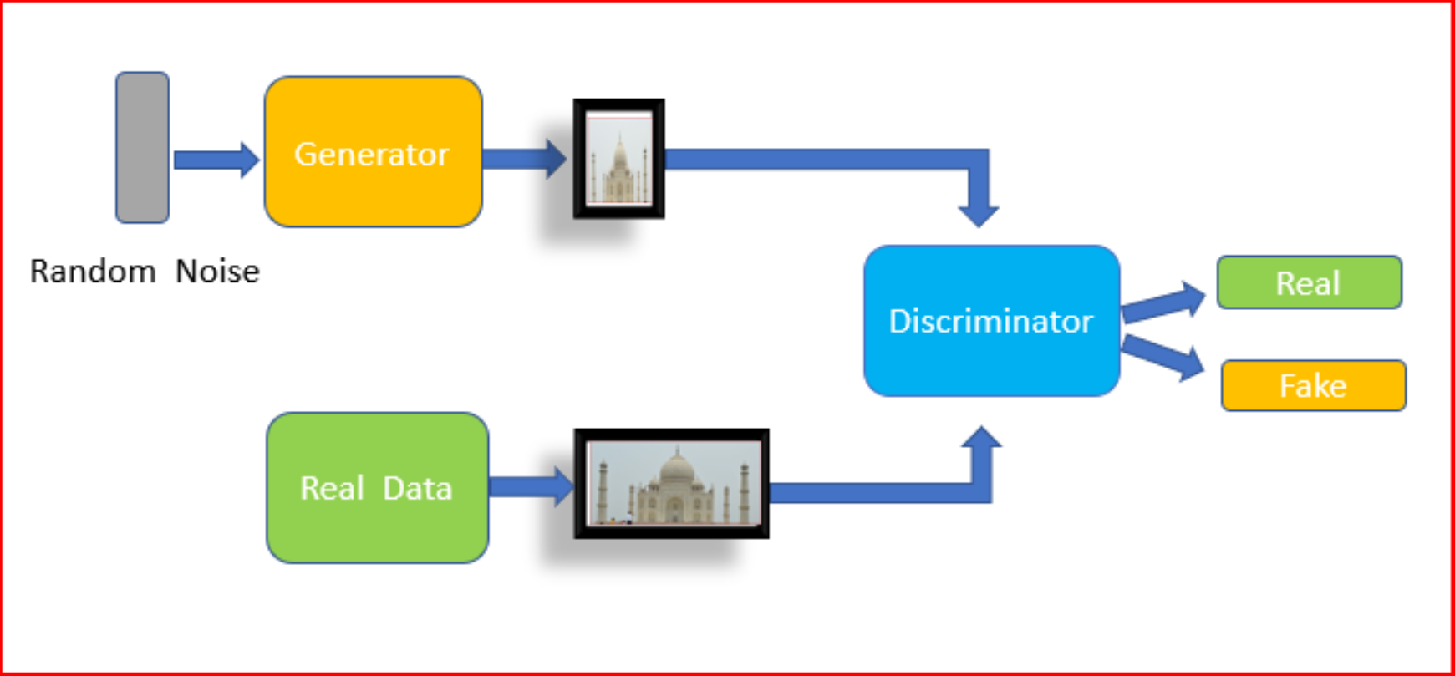
GANs
Discriminator ( Critic ) determines error
Generator can be used to create new data ( medical imaging )

Slide 6
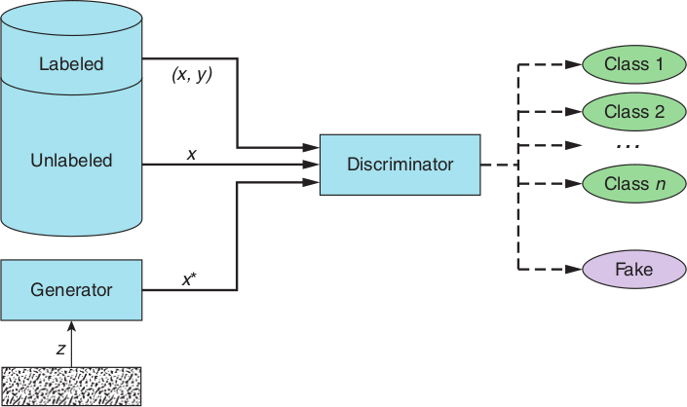
Semi Supervised GAN
Can be used with partially labeled data ( Kannada/MNIST )
( different distribution btwn train/test/val data, used only 4k labeled images of 40k, 81% accuracy)

Slide 7
Code
RL GANs —- World Models https://worldmodels.github.io/
Really Awesome GAN resources https://github.com/nightrome/really-awesome-gan
Keras GANs https://github.com/eriklindernoren/Keras-GAN
Numpy GAN https://github.com/shinseung428/gan_numpy
Kannada code
https://github.com/timestocome/Kaggle/tree/master/SemiSupervised%20GAN%20Kannada%20MNIST

Slide 8
Resources
Paper
Generative Adversarial Nets
https://papers.nips.cc/paper/5423-generative-adversarial-nets.pdf
Books
Generative Deep Learning: Teaching Machines to Paint, Write, Compose, and Play (O'Reilly)
GANs in Action ( Manning)

